Slide 1









Elixir Safe, yet Practical
https://github.com/tomjoro/elixir_meetup/slides
Thomas O’Rourke
Elixir
THE IMPOSSIBLE FUTURE!!
It’s not practical!
It’s only for
propeller heads.
These slides are
(c) 2020 Thomas O’Rourke

Slide 2
Feedback from Oulu
More please
Compare to Clojure, Lambda, Go, etc. (bashing/debate is stimulating)
How/Why you started using Elixir/Erlang?
Real life stores of using Elixir?
Code examples
Some too abstract ideas
Better to just show code
Elixir practical questions
How to debug
How to test Elixir – testing tells you a lot about a language
How to handle process failures

Slide 3
Why “The impossible future”?
We have heard…
It’s too academic (just weird)
It’s too new – use Java or something on JVM, so it interoperates (then they use Lambdas)
You can’t hire or train Elixir developers
It’s unlike other languages – it’s impossible to Safety, reliability, simplicity, concurrency, scalability – you are dreaming
How will we security audit it?
How will we deploy it? We don’t need another pipeline
It’s unproductive for simple things – will slow down schedules, etc.
We’re betting on _______ (Go, Lambdas, etc.) Are you betting on Elixir?
Here more at ElixirEU 2020 – “Taking Elixir Live at a Bank”

Slide 4

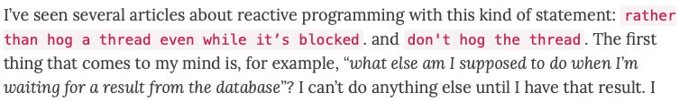
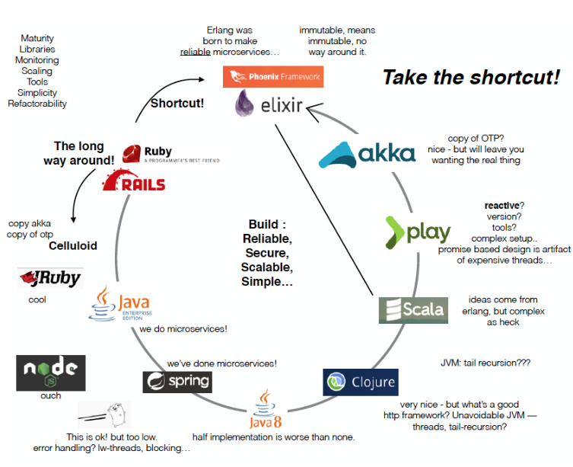
My Blog: tomjoro.github.io
Elixir – Erlang didn’t change, the world did
Guns and why Elixir is relevant graph
https://tomjoro.github.io/2017-01-31-world-changed/
Top of Reddit r/programming
It's Windows 3.1 All Over Again
Very popular blog. Don’t hog the thread.
Why I want processes and they are mine.
https://tomjoro.github.io/2017-02-03-why-reactive-fp-sucks/
Why should we "reinvent the wheel" by using Akka with Java if we have Elixir/Erlang ready for production?
I tried them all. Wanted an actor framework
https://tomjoro.github.io/2018-09-17-why-use-akka-when-you-can-use-erlang/
Notes:
https://cacm.acm.org/magazines/2010/9/98014-erlang/fulltext

Slide 5









Who’s using Elixir?
Pivo Kasvomaksu
& others!
90% of the internet goes through Erlang connected nodes
https://twitter.com/guieevc/status/1002494428748140544
https://www.svt.se/nyheter/utrikes/betala-med-ansiktet-sa-gar-det-till
Notes:
And for What?
Because if it were in Finnish, you’d think it is boring.. ☺
Elixir is Erlang

Slide 6
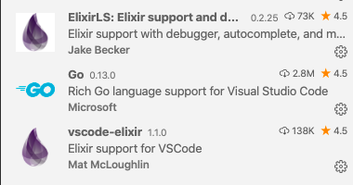
Elixir is Different
https://github.com/tomjoro/elixir_safe_practical
Clone my repo
https://github.com/tomjoro/elixir_safe_practical/code/part1
Visual Studio Code
Step 1: install Elixir
Step 2: start iex
Step 3: Fun!
Padwan, you must accept
these truths or your journey
will be short and troubled

Slide 7
Immutable
➜ ElixirSafePractical iex
Erlang/OTP 22 [erts-10.6.3] [source] [64-bit] [smp:16:16] [ds:16:16:10] [async-threads:1] [hipe] [dtrace]
Interactive Elixir (1.10.0) - press Ctrl+C to exit (type h() ENTER for help)
iex(1)> my_map = %{"safe" => true, "practical" => true}
iex(2)> my_map2 = Map.put(my_map, "fun", true)
iex(3)> Map.put(my_map2, "mutable", false)
iex(4)> my_map2
%{"practical" => true,
"safe" => true}
%{"fun" => true, "practical" => true, "safe" => true}
%{"fun" => true, "mutable" => false, "practical" => true, "safe" => true}
%{"fun" => true, "practical" => true, "safe" => true}
iex(5)> my_map2 = "names are not mutation"
"names are not mutation"
Notes:
I hate it when people categorize it as: Elixir is not pure functional. “if you give the same input you get the same output”. If it were, it would be impractical.
https://www.youtube.com/watch?v=PpA6LfyN6Rs: at 1:35
Side effect free

Slide 8




Immutability
Elixir
iex(1)> my_map = %{"safe" => true, "practical" => true}
%{"practical" => true, "safe" => true}
iex(8)> r = OtherModule.some_function(my_map)
irb(main):001:0> my_map = {"practical" => true, "safe" => false}
=> {"practical"=>true, "safe"=>false}
irb(main):002:0> some_obj = SomeClass.new()
iex(9)> IO.puts "#{inspect(my_map)}"
irb(main):003:0> r = some_obj.some_method(my_map)
irb(main):004:0> puts "#{my_map}"
OtherModule.some_function
some_obj.some_method
Are Elixir function parameters pass by reference or pass by value?
Notes:
Answer: It doesn’t matter.
You can’t know in Ruby what the value is with my_map
Some languages have immutability!
But Elixir doesn’t not have immutability → For finnish readers! ☺
If you think that’s slow – you’d be wrong. GC takes care of things!

Slide 9


Seriously immutable
Simple: Modules are flat.
Every module can be seen globally by everyone
defmodule IfElse do
def func2(b) do
if true do
IO.puts "#{b}"
b = 42
c = 5
end
IO.puts "#{c}”
b
end
end

Slide 10
defmodule IfElse2 do
def func1 do
a = 3
{b, c} = func2(a)
IO.puts "#{a} #{b} #{c}"
end
def func2(m) do
{m, n} = if true do
b = 4
c = 5
{b, c}
end
{m, n}
end
end
It works like a function!?

Slide 11

Let’s write a loop
defmodule Loop do
def start do
IO.puts "Welcome to my loop program"
loop(5)
end
def loop(0) do
IO.puts("Sorry, try again next time.")
end
def loop(remaining) do
input = IO.gets "Try: #{remaining} Please guess my age > "
{i, junk} = Integer.parse(input)
cond do
i < 54 -> IO.puts "Guess higher"
i > 54 -> IO.puts "Guess lower"
true -> IO.puts "Correct!"
end
loop(remaining-1)
end
end
Loop.start
elixir loop.ex
Notes:
Let’s do it together

Slide 12

Processes
elixir processes.ex
Recursion is the only way to loop
This is a process! At the heart of every process (and program) is a loop (recursion)
Isolated memory
A process loop stores state by “sending it back to myself” – what?
defmodule Loop1 do
def init() do
pid = spawn(Loop2, :init, [])
loop(pid)
end
def loop(pid) do
send(pid, "Hello from loop1")
:timer.sleep(1000)
loop(pid)
end
end
defmodule Loop2 do
def init() do
IO.puts "Loop2 starting"
loop()
end
def loop() do
receive do
string -> IO.puts string
_ -> IO.puts "I don't understand"
end
loop()
end
end
mailbox
"
"
Hello from loop1
Hello from loop1
Hello from loop1
memory
memory
Sync or
async
process
process
Notes:
OTP makes this easier. GenServer.

Slide 13
Elixir is Simple
data_examples.ex
String/Binary
Symbols
Lists
Maps
Tuples
“a string”
Modules
Functions
If / else, case, cond
Maps
Tuples
Loops = recursion
Spawn processes and send and receive)
:a
[ “one”, “two” ]
%{“fun” => true}
{”one”, “two}
# pattern matching
map = %{"map_with_strings" => 1, :mixed => 3}
%{"map_with_strings" => whats_value} = map
other = 99
3 |> pipe(other) |> pipe(44)
# anonymous functions
list = [1, 2, 3, 4]
even = Enum.filter(list, fn x -> rem(x, 2) == 0 end)
list = [ 1, 2, 3]
list = [ 0 | list] # push on head of list
Notes:
You already know so much about Elixir

Slide 14
How do I work with Elixir
Emacs or VI?
(now fight)
Visual Studio Code, Atom, VI, Emacs
Mix
Hex
iex
BEAM
Phoenix*
Functions
Anonymous Functions (closures)
Processes
Modules
Macros

